Slide 1
House Price Prediction using Machine Learning
-
-

Slide 2
Introduction
Objective/ Problem statement: House price prediction.
This dataset Consists of 7 Attributes They are
Square Footage
Number of Bedrooms
Number of Bathrooms
Year Built
Lot Size (in acres)
Garage Size
Neighborhood Quality

Slide 3
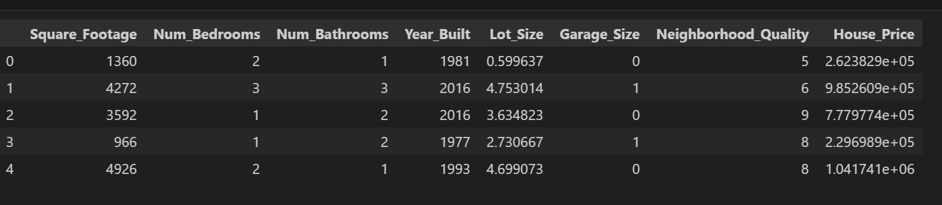
Key Features

Slide 4
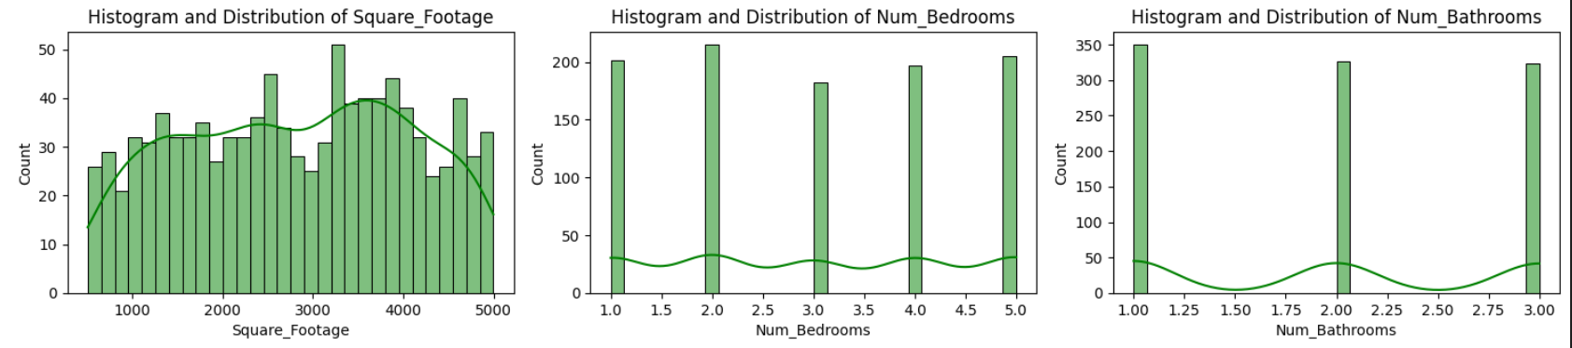
Visualization of Key Attributes

Slide 5
Data Collection
Source: Kaggle
Type: Relational Dataset.
Quantity: Dataset contain Rows:1001
Columns:7
For web integration Using Streamlit.

Slide 6
Data Preprocessing
Cleaning: Steps taken to clean the data.
Handling Missing Values: Identify and address any missing data by either imputing values or removing rows/columns with significant missing information.
Syntax : df.isnull().sum()
Removing Duplicates: Check for and remove duplicate rows to ensure data integrity.
Normalizing Data: Standardize data formats, such as dates and numerical values, to ensure consistency.

Slide 7
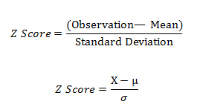
Z – SCORE NORMALIZATION

Slide 8
Data Preprocessing
Outlier Detection: Identify and manage outliers that could skew your analysis.
Outliers are data points that are significantly different from the rest of the data.
Dealing with Noise: Remove any irrelevant or redundant data.
Noisy data is a data set that contains extra, meaningless information that can distort the true signal or pattern in the data

Slide 9
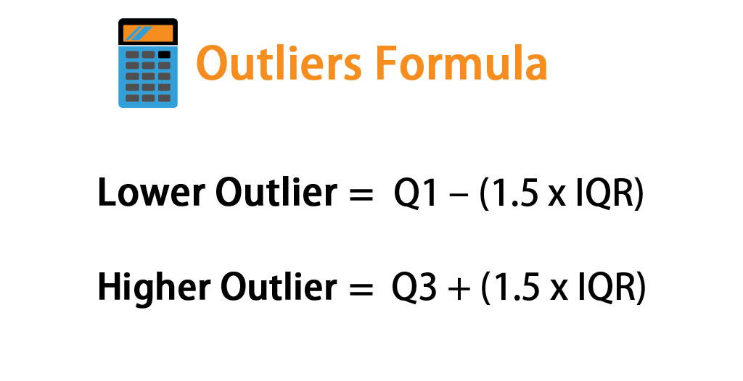
FORMULA

Slide 10
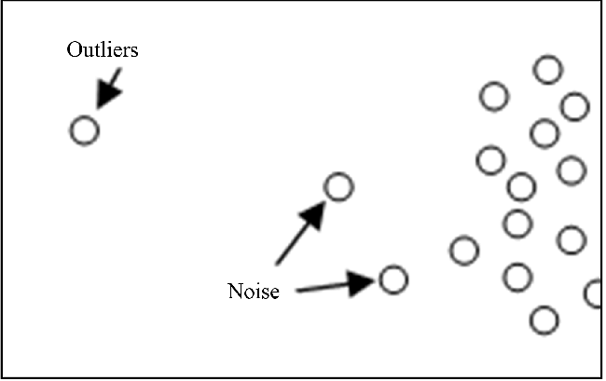
Outliers and Noise

Slide 11
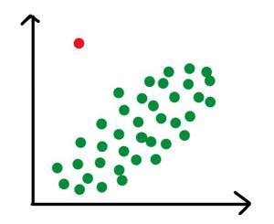
Outlier

Slide 12
Data Preprocessing
Transformation: Any transformations or feature engineering performed.
Normalization/Standardization: Scaling features to a standard range or distribution, like using StandardScaler in scikit-learn.
Encoding Categorical Variables: Converting categorical variables into numerical format using techniques like one-hot encoding or label encoding.
Creating New Features: Generating new features from existing ones. For example, extracting the day, month, and year from a date feature.

Slide 13
Data Preprocessing
Splitting: How you split the data into training and testing sets.
Splitting your dataset into training and testing sets is a fundamental step to ensure your model's performance is properly evaluated.
from sklearn.model_selection import train_test_split
X = df.drop(columns=['House_Price'],axis=1)
y = df['House_Price']
X_train, X_test, y_train, y_test = train_test_split(X, y, test_size=0.2,random_state=42)

Slide 14
Data Preprocessing
Separate the features (X) from the target variable (y).
Split the data into training and testing sets with 80% of the data used for training and 20% for testing.
Using random_state ensures that you get same split each time you run the code

Slide 15
Exploratory Data Analysis (EDA)
Visualizations: Key graphs and plots to understand the data.
Histograms
Purpose: Show the distribution of a single numerical feature.
Boxplots
Purpose: Display the distribution of a numerical feature and highlight outliers.

Slide 16
Exploratory Data Analysis (EDA)
Scatter Plots
Purpose: Show the relationship between two numerical features.
Pair Plots
Purpose: Visualize pairwise relationships in a dataset.
Correlation Heatmap
Purpose: Show the correlation between numerical features.

Slide 17
Exploratory Data Analysis (EDA)
Line Plots
Purpose: Show trends over time.

Slide 18
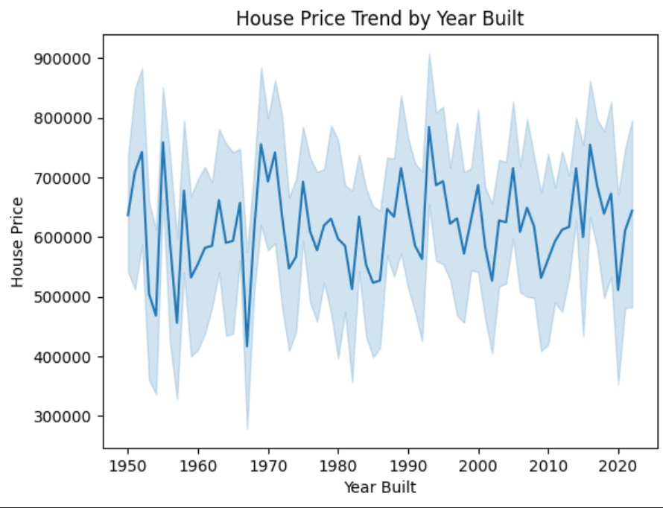
Exploratory Data Analysis (EDA)

Slide 19
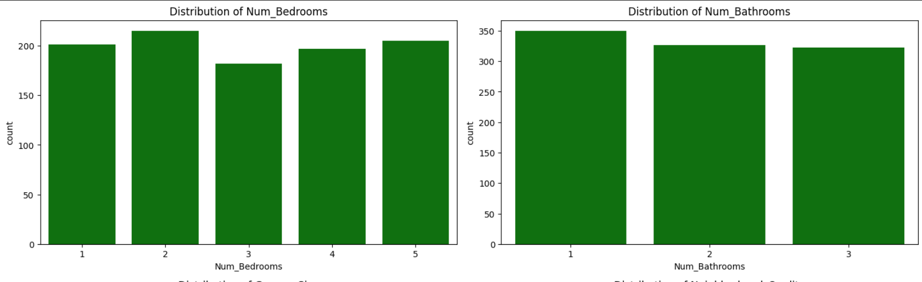
Exploratory Data Analysis (EDA)

Slide 20
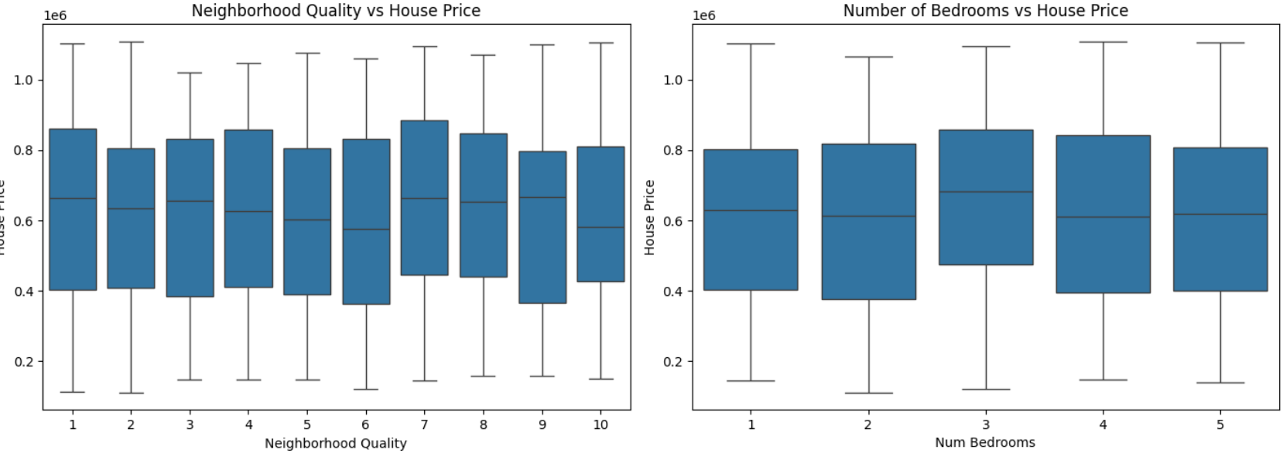
Exploratory Data Analysis (EDA)

Slide 21
Model Selection
Algorithms:
Linear Regression
Used as the primary algorithm for predicting house prices based on numerical and categorical features.
Suitable for this project as it models the relationship between input features and the target variable (price).

Slide 22
Model Selection
Linear Regression
Decision Trees
Random Forest
Support Vector Regression (SVR)

Slide 23
Model Selection
Linear Regression
Ridge Regression
Lasso Regression

Slide 24
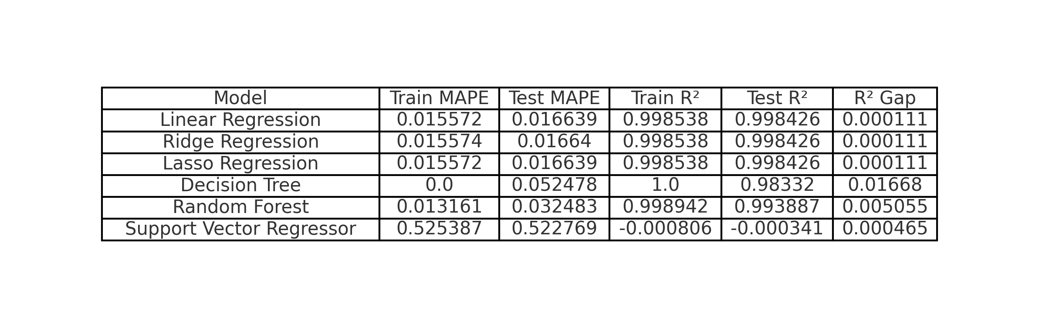
Model Evaluation
Metrics:

Slide 25
Model Evaluation
Results:
Model Selection: Linear Regression
Why: Simple, interpretable, and performs well with low MAPE (0.015572 train, 0.016639 test) and high R² (0.998538 train, 0.998426 test).
Comparison: Performs similarly to complex models but with lower complexity and minimal overfitting.
Conclusion: Chosen for its accuracy, simplicity, and effectiveness in predicting crop prices.

Slide 26
Model Deployment
Deployment
The model was deployed using Streamlit, offering a user-friendly interface for real-time predictions.
Users can input house features , and the backend processes the inputs to generate predictions instantly.
The app was run locally using streamlit run app.py, with preprocessing handled dynamically for compatibility with the model.
Tools: Tools and platforms used for deployment.

Slide 27
Conclusion
Accurate Predictions: The app leverages Linear Regression to predict house prices with high accuracy, as demonstrated by low MAPE and high R² values.
User-Friendly Interface: Provides an intuitive platform for users to input features and receive instant price predictions.
Practical Application: The model and app serve as a valuable tool for real estate professionals, buyers, and investors to make informed decisions.
Future Improvements: Potential for adding more complex models, user customization, and additional features like location-based predictions.

